Slide 1

What we did
Enhanced graph code – merged same entity together
Nodes matching accuracy – w2v:
$\frac{\# accurately matched nodes}{\# total nodes}=0.16$ compared to 0.13 before
$\frac{\# accurately matched nodes}{\# nodes that can be matched}=0.64$ compared to 0.58 before
Need to test on a different set of data

Slide 2
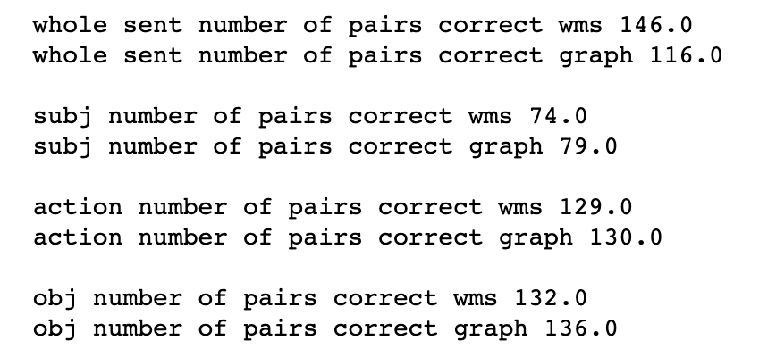
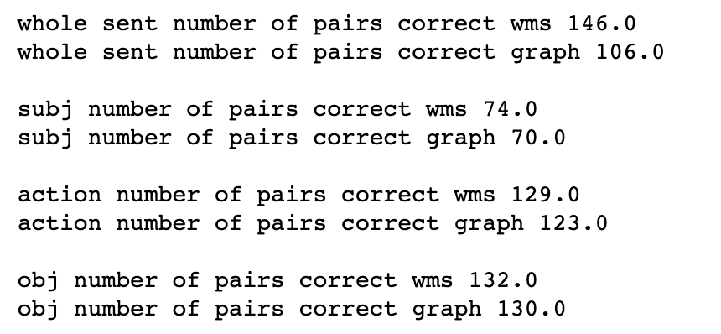
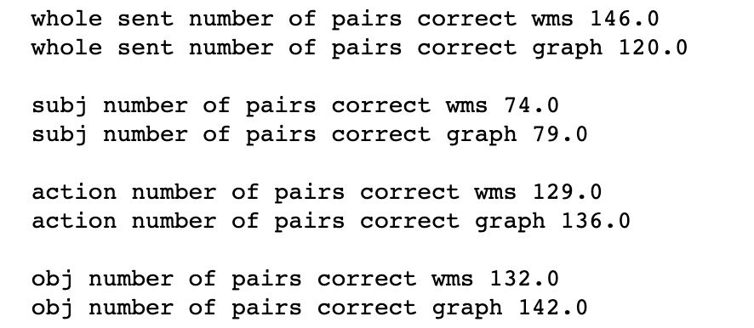
30 sentence ranking results
Threshold 0
Threshold 0 (old)
Threshold 0.9

Slide 3
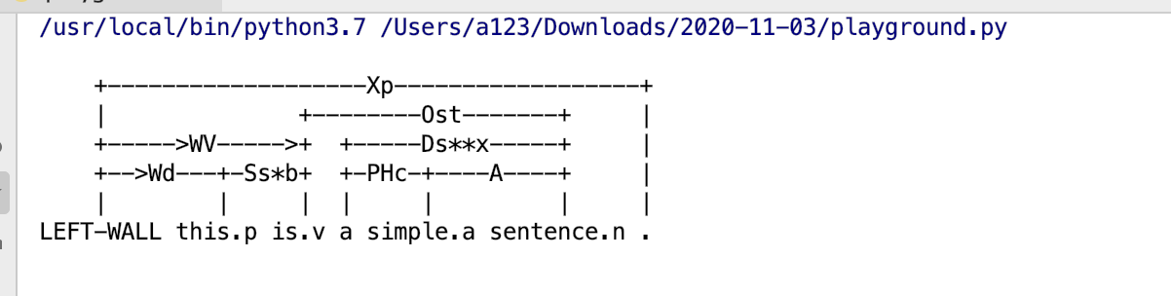
Linked grammar results

Slide 4
Next steps
Use linked grammar to calculate similarity
Merge node on a higher level -> group matching
Get a vector from phrase
Two directions
Matching at low level
Matching at summarization level -> merged node level

